Slide 1
Statistics - Discussion

Slide 2
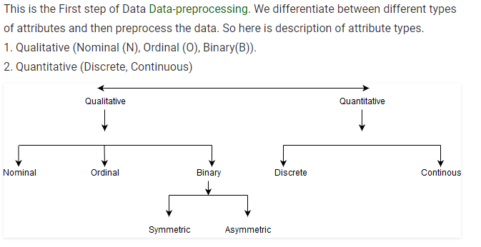
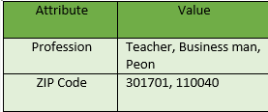
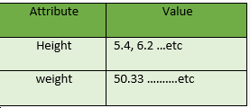
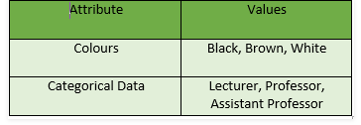
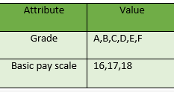
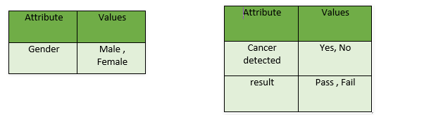
Notes:
Ordinal data in ranking order but magnitude btween values are not known, it shows only the order of importance not the importance of the value.

Slide 3
Quantitative
Numeric : A numeric attribute is quantitative because, it is a measurable quantity, represented in integer or real values. Numerical attributes are of 2 types, interval and ratio.
i) An interval-scaled attribute has values, whose differences are interpretable, but the numerical attributes do not have the correct reference point or we can call zero point.
ii) A ratio-scaled attribute is a numeric attribute with an fix zero-point. If a measurement is ratio-scaled, we can say of a value as being a multiple (or ratio) of another value. The values are ordered, and we can also compute the difference between values, and the mean, median, mode, Quantile-range and Five number summary can be given.
Notes:
Data can be added and subtracted at interval scale but can not be multiplied or divided.Consider a example of temperature in degrees Centigrade. If a days temperature of one day is twice than the other day we cannot say that one day is twice as hot as another day.

Slide 4
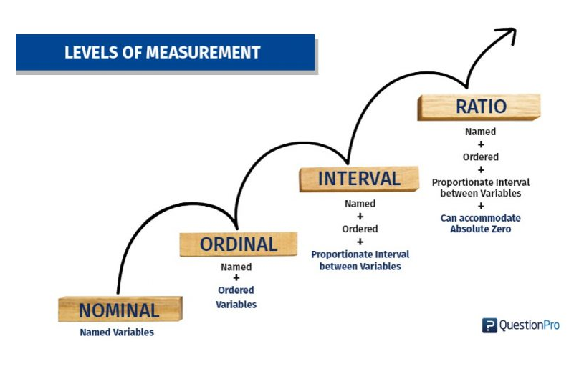
Notes:
Data can be added and subtracted at interval scale but can not be multiplied or divided.Consider a example of temperature in degrees Centigrade. If a days temperature of one day is twice than the other day we cannot say that one day is twice as hot as another day.

Slide 5


Quiz
Is Temperature Interval or ratio?
Is Year interval or ratio ?
Is the mean and median can be evaluated in 1st level and 2nd level of measurement.
Mean, Median and Mode are?????
Calendar years and time also fall under this category of measurement scales.
Net Promotor Score.
Which one has negative value ? Ratio or Interval
What is your weight in kilograms? Less than 50 kilograms
What is your son current height?
5 feet 1 inch – 5 feet 5 inches

Slide 6
Parameters vs Statistic
Proportions from Random Samples Vary
Imagine a small college with only 200 students, and suppose that 60% of these students are eligible for financial aid.
In this simplified situation, we can identify the population, the variable, and the population proportion.
Goal: One of the goals of inference is to draw a conclusion about a population on the basis of a random sample from the population.
Population: 200 students at the college.
Variable: Eligibility for financial aid is a categorical variable, so we use a proportion as a summary.
Population proportion: 0.60 of the population is eligible for financial aid.

Slide 7
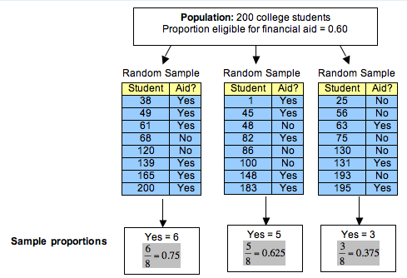
Parameters vs Statistic
A lot of variability occurs in these sample proportions. It is not surprising, therefore, that a sample of 8 students may give an inaccurate estimate for the proportion of those eligible for financial aid in the population. It makes sense that small samples of only 8 students may not represent the population accurately.
Will it improve if we increase the sample size???????
Inferences:
Each random sample came from a population in which the proportion eligible for financial aid is 0.60, but sample proportions vary. Each random sample has a different proportion who are eligible for financial aid.
Some sample proportions are larger than the population proportion of 0.60; some sample proportions are smaller than the population proportion.
Some samples give good estimates of the population proportion. Some do not. In this case, 0.625 is a much better estimate than 0.375.

Slide 8
Parameters vs Statistic
Goal: One of the goals of inference is to draw a conclusion about a population on the basis of a random sample from the population.
A parameter is a number that describes a population.
A statistic is a number that we calculate from a sample.

Slide 9
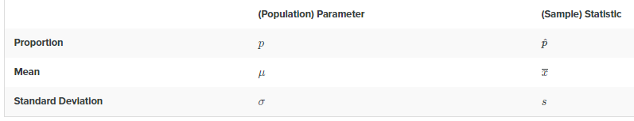
Parameters vs Statistic
According to the voter registration statistics reported by the state of California for 2015, of over 24 million in California eligible to vote, approximately 73% were actually registered to vote.
According to the Public Policy Institute of California, Democrats in California are more likely to vote. In their 2015 publication Just the Facts, they state,“ Our surveys indicate that among those we consider most likely to vote, 43% are Democrats, 32% are Republicans, and 20% are independents.”
Indicate if each proportion is a parameter or statistic.
73%
Is this 73% is Parameter or Statistics

Slide 10
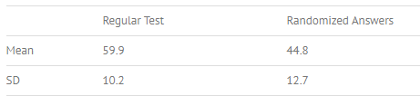
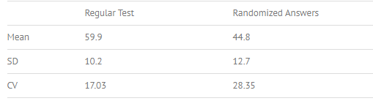
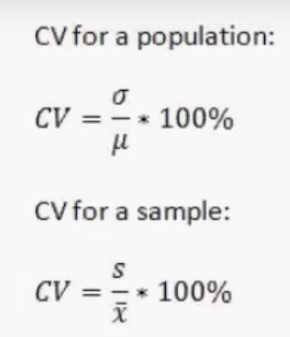
Coefficient of Variation – Explain with an example
A researcher is comparing two multiple-choice tests with different conditions. In the first test, a typical multiple-choice test is administered. In the second test, alternative choices (i.e. incorrect answers) are randomly assigned to test takers. The results from the two tests are:
standard deviations of 10.2 and 12.7,
Regular test: CV = 17.03 Randomized answers: CV = 28.35
Formulae:
Also now as Sharpe Ratio:
Better Explained in
https://www.investopedia.com/articles/07/sharpe_ratio.asp
Notes:
Trying to compare the two test results is challenging. Comparing standard deviations doesn’t really work, because the means are also different. Calculation using the formula CV=(SD/Mean)*100 helps to make sense of the data:

Slide 11
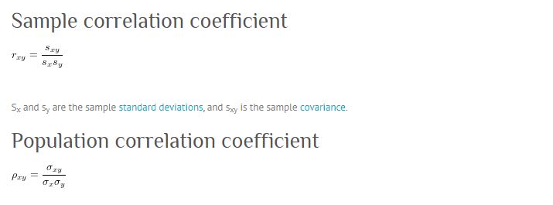
Correlation Analysis
First We need to understand Covariance, because Correlation Formulae is

Slide 12
Detailing with example
Let us take sample data of the ice-cream sales based on the temperature
Temperature | Ice Cream Sales
66 | 8
72 | 11
77 | 15
84 | 20
83 | 21
71 | 11
65 | 8
70 | 10
 | Temp | Icecream
Mean | 73.5 | 13
Std Dev | 7.19 | 5.13
Covariance = 36.42
Correlation = 36.42/7.19*5.13
0.999

Slide 13
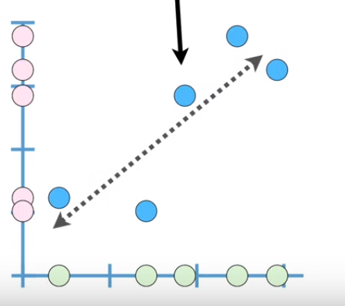
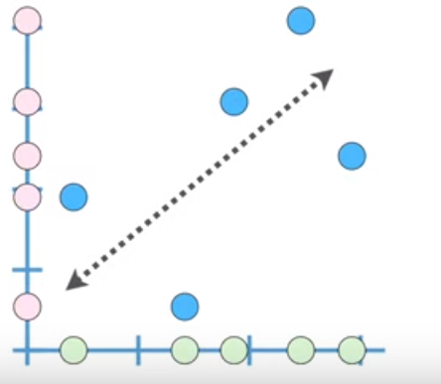
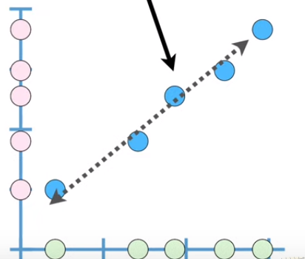
Which has large correlation , medium correlation and weak correrlation
Need to understand about confidence interval also.

Slide 14
Relationship with categorical variable
The chi-square test for two-way tables is used as a guideline for declaring that the evidence in the sample is strong enough to allow us to generalize that the relationship holds for a larger population as well.
Definition: A statistically significant relationship is a relationship observed in a sample that would have been unlikely to occur if really there is no relationship in the larger population.
Concept : A chi-square statistic for two-way tables is sensitive to the strength of the observed relationship. The stronger the relationship, the larger the value of the chi-square test.
Definition : A p-value for a chi-square statistic is the probability that the chi-square value would be as large as it is (or larger) if really there were no relationship in the population.
IMPORTANT decision rule : An observed relationship will be called statistically significant when the p-value for a chi-square test is less than 0.05. In this case, we generalize that the relationship holds in the larger population.
Assumptions: The two variables must be categorical and expected counts in each cell must be at least five.

Slide 15
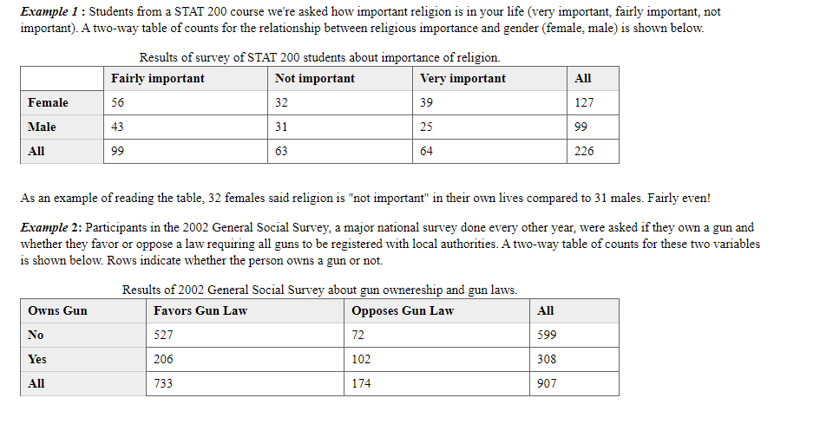
Examples

Slide 16
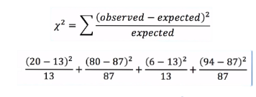
Detailing with example for categorical analysis
Two Group comparison Do women have greater risk of developing tennis elbow.
USA
P(women) = 11/100 = 0.11
P(men) = 10/100 = 0.1
 | TE | No TE
Women | 11 | 89
Men | 10 | 90
Australia
 | TE | No TE | Total
Women | 20 (13) | 80 (87) | 100
Men | 6 (13) | 94 (87) | 100
 | 26 | 174
CHI SQUARE = 8.664 FOR ONE DEGREE OF FREEDOM
P- VALUE = 0.0032

Slide 17
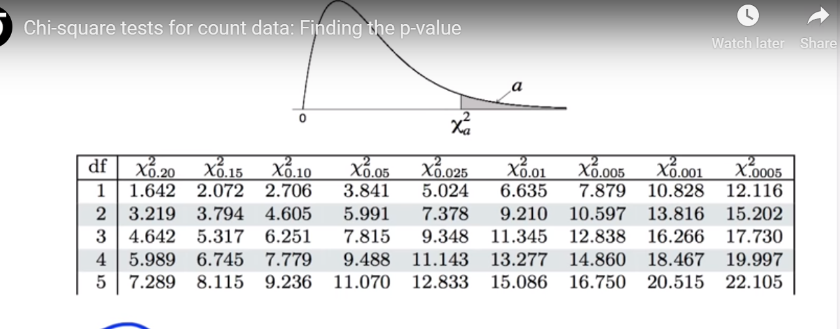
Degrees of freedom
The mean of a Chi Square distribution is its degrees of freedom. Chi Square distributions are positively skewed, with the degree of skew decreasing with increasing degrees of freedom. As the degrees of freedom increases, the Chi Square distribution approaches a normal distribution

Slide 18
Need to understand about confidence interval also.

